Slide 1

Mortality in the Netherlands during the COVID-19 pandemic
Big Data Matters 3
The Need for Timely Official Statistics
Lenny Stoeldraijer CBS
Notes:
Thank you, Sofie. I am Lenny Stoeldraijer and I will give a presentation on mortality in the Netherlands during the COVID-19 pandemic.

Slide 2
The Netherlands, beginning 2020
National Institute of Public Health (NIPH, in Dutch: RIVM)
Low capacity for testing on coronavirus
-> Underestimation of incidence of COVID-19
Medical doctors have no obligation to report deaths to NIPH
-> Tracing cause of death incomplete
Statistics Netherlands
Procedure: cause of death form on paper and anonymous
-> Available after 6 months
How many people die of COVID-19? UNKNOWN!
Notes:
In the beginning of 2020 we saw that the national instutitute of public health was unable to register all deaths due to COVID-19. There was only little testing what caused that the incidence of COVID-19 was underestimated. And there is no obligation to report the deceased from COVID-19 causing an imcomplete number of people that died of COVID-19.
At Statistics Netherlands we receive cause of death forms which do include information on who died of COVID-19, but because of manual processing this would become available after six months.
So, it was unclear how many people died because of COVID-19 in the Netherlands in a timely manner, something that was very relevant to know for policy.

Slide 3
Timely statistics on total mortality
Digital population register for the Netherlands
Includes all deaths
-> complete picture of total mortality
and in a timely manner!
Notes:
However, in the Netherlands we have a digital population register of all municipalities in the Netherlands. In this system also deaths are reported. At Statistics Netherlands we have this information very quickly, the day after the information is entered. We were therefor in a position to give a complete picture regarding total mortality in the Netherlands in a timely manner.

Slide 4
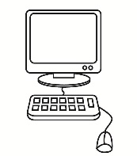


Situation in the Netherlands
Death certificate
±1 day
±1 week
Cumulating
Publication of total mortality after 2 weeks
Preparer
Municipality
Statistics Netherlands
Cause of death form
±1 month
Processing (manually)
Coding
Publication of cause of death after 6 months
Statistics Netherlands
Notes:
So, how does it work in the Netherlands? When someone dies, a medical examinar fills in a cause of death form. This is then submitted to the municipality, together with a death certificate.
The death certificate is registered in the population register. This is recieved by Statistics Netherlands the next day. After two weeks, we publish the total number of deaths.
The cause of death form is sent to Statistics Netherlands to be processed and coded. Because of the paper forms, this is done manually. After six months we publish the cause of death of all persons that died in the Netherlands.

Slide 5
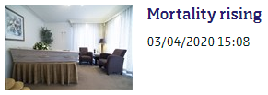
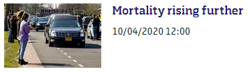
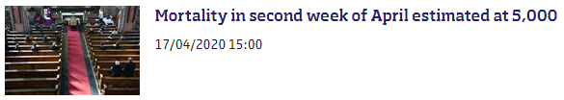
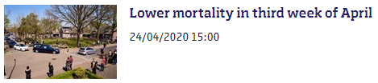


Mortality statistics (from April 2020 onwards)
More frequent: weekly instead of 2-weekly
More timely: estimate of the previous week
More detail: e.g. regional numbers
And new publications…
Notes:
From the beginning of the first wave of the COVID-19 epidemic in the Netherlands, we published weekly on the number of deaths instead of twoweekly.
We added an estimate of mortality in the previous week, based on the number of deaths received so far.
We also included more detail in what we publish, for instance regional numbers.
We also had new publications…

Slide 6
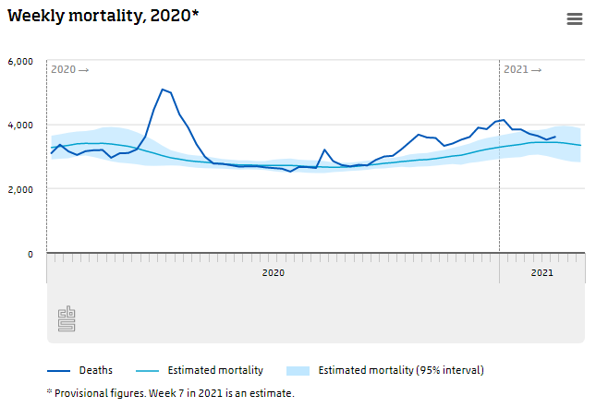
New: estimate of excess mortality
Excess mortality =
Deaths (observed)
–
Estimated mortality
(if there was no epidemic)
Notes:
The first new thing we added to our publications was an estimate of the mortality if there was no epidemic.
The deaths we observe above the estimated mortality is called excess mortality.
The excess mortality is a first estimate of how many people died of COVID-19 and gives an indication of the severity of the epidemic.
Because of the very timely figures on total mortality, this can be presented in a very timely matter.
In 2020 the excess mortality was about 15 thousand, 10 percent higher than estimated.

Slide 7
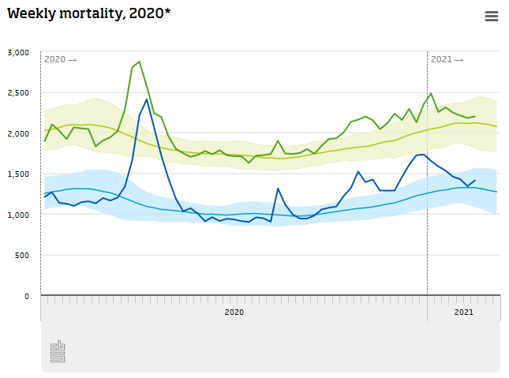
New: mortality among long-term care users
Absolute figures!
Mortality in general population
Mortality in long-term care users
Notes:
We also combined mortality with information about long-term care users, such as people in nursing homes.
It gives information about mortality in our most vulnerable population.
We have seen that long-term care users are more severly affected by the COVID-19 epidemic.
During the first wave the mortality among long-term care users doubled, whereas in the general population the mortality increased by a half.

Slide 8
Currently
Nat. Institute of Public Health: timely, but under-reported COVID-19 mortality
Statistics Netherlands: complete COVID-19 mortality, publication after ±4 months (instead of 6)
Excess mortality still a good early indicator of COVID-19 mortality
2020 ->
2021 ->
(Nat. Institute of Public Health)
(Statistics Netherlands)
Notes:
We have seen that mortality reported by our National Institute of Public Health is timely, but still under-reported. In the figure it is represented bij the red line.
At Statistics Netherlands, we have worked hard to publish our cause of death statistics about two months earlier. So in 4 months instead of 6. It is presented in the figure by the green line.
With this information on who died on COVID-19, we have seen that excess mortality is entirely due to COVID-19 and therefor a good indicator for COVID-19 mortality.
We will therefor continue publishing on total mortality in the Netherlands.

Slide 9

Joint efforts to make timely mortality statistics
Complete picture on COVID-19 mortality, thanks to collaboration with National Institute of Public Health
More testing
Weekly total mortality figures
Faster cause of death publication
Better understanding of mortality
among vulnerable population
Notes:
By more testing, weekly publications on total mortality, faster cause of death publication and a better understanding of mortality among the most vulnerable population,
We were able, in a joint effort with our National Institute of Public health,
to present a complete picture on COVID-19 mortality in the Netherlands in a timely matter.
Thank you for your attention. I will now give back the microfoon to Martijn Tennekes for the next presentation about mobility.

