Slide 1
Towards climate-related indicators
[Please select]
[Please select]
14 March 2023
Justin Dijk (DNB)

Slide 2
Overview
1
Introduction
2
Sustainable finance
3
Carbon emissions
4
Physical risks
5
Conclusion

Slide 3
1. Introduction

Slide 4
Introduction
Impact of green transition and climate change on entire economy, and specifically financial sector; better understanding of developments & risks needed.
In line with Governing Council action plan, ECB, DNB and ESCB (all other NCBs) committed to produce statistical indicators to be able to follow trends at aggregate level.
Indicators to inform monetary policy making, provide reference for financial stability analyses and support public understanding.
Where possible, data is sourced from public/ESCB data collections; methodology made fully transparent.
New experimental and analytical indicators, like all similar data, come with significant limitations, to be used and analysed with care.
Project is work in progress and our contribution to ongoing discussion (feedback is very welcome!).
The first dataset has been published in January 2022 on the ECB and DNB website and is expected to be updated end of 2023/beginning 2024.

Slide 5
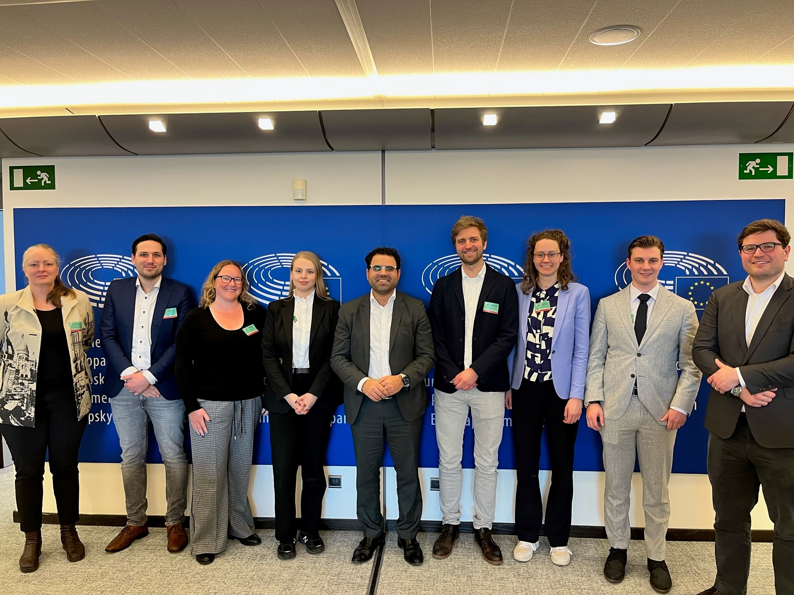
Example of our publication strategy: Pro-actively gathering feedback at EP

Slide 6
2. Sustainable finance
Experimental indicators

Slide 7
Experimental indicators on sustainable finance
Indicators constructed based on ESCB data sources: Centralised Securities Data Base (CSDB), CSDB Securities Issues Statistics (CSEC) and Securities Holdings Statistics (SHS)
Time-series information on outstanding amounts and financial transactions related to the issuances and holdings of sustainable debt securities
Indicators provide views on both, the funding needs of sustainable projects and the demand for these debt securities as investment opportunities
Indicators are sufficiently reliable for use. However, when using the data, analysts should be particularly conscious of the methodological decision to currently include all degrees of assurance in the definition of sustainable debt securities, including self-labelled securities

Slide 8
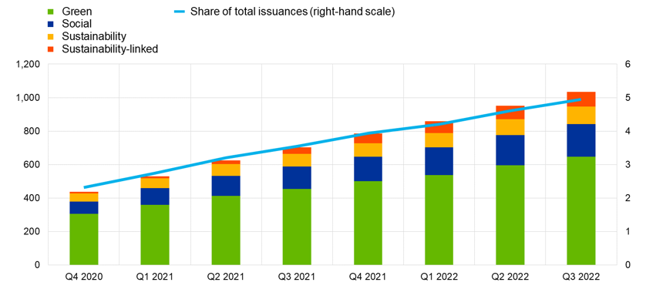
Issuances of sustainable debt securities in the euro area
Measure
The amount outstanding of euro area (EA) issuances of sustainable debt securities by sustainability classification
left-hand scale: EUR billions, outstanding amounts; at face value; right-hand scale: percentages
Key findings
Outstanding amount of sustainable debt securities issued by EA has more than doubled in the last two years, with green debt securities leading the market
The relevance of sustainable debt in the overall debt securities market remains minor
Caveats
All assurance levels are considered (self-labelled, with a second-party-opinion, certified)
No restriction on underlying standards
Source: Centralised Securities Database (CSDB) Notes: Observed amounts refer to the last day of the reference period. The share of total issuances represents the amount of all sustainable securities as a share of the outstanding amounts of all debt securities issued in the euro area. Sustainability classification: Green, Social, Sustainability, Sustainability-linked

Slide 9
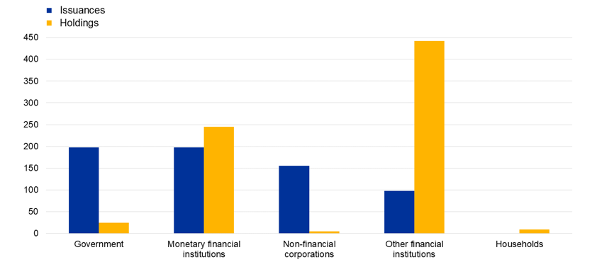
Issuances and holdings of green debt securities by sector
Measure
The amount outstanding of euro area (EA) issuances and holdings of green debt securities by sector
EUR billions; Q3, 2022; outstanding amounts; at face value
Key findings
Government, MFIs and NFCs are the leading issuing sectors of green debt securities in the EA, with comparable market shares;
OFIs (mostly investment funds) are the main investors on green debt securities, followed by MFIs, including NCBs;
Households invest on green debt securities only indirectly via investment funds
Caveats
All assurance levels are considered (self-labelled, with a second-party-opinion, certified)
No restriction on underlying standards
Source: CSDB and Securities Holdings Statistics (SHS) Notes: Observed amounts refer to the last day of the reference period. Government: General Government Monetary Financial Institutions (MFIs): Central Bank (CB), Deposit-taking corporations except the central bank, Money market funds Non-Financial Corporations (NFCs) Other Financial Institutions (OFIs): Non-MMF investment funds, Other financial intermediaries except ICPFs, Financial auxiliaries, Captive financial institutions and money lenders, Insurance corporations, Pension funds Households: Households and non profit institutions serving households

Slide 10
3. Carbon emissions
Analytical indicators

Slide 11
Carbon emission indicators link financing and corporate emissions
Indicators constructed based on the ESCB Non Financial Corporations’ loans and securities holding (equity and corp. bonds) databases and climate data
Estimates emissions financed through loans, corp. debt securities and listed shares for direct (scope 1) and indirect emissions from energy purchase (scope 2; only for securities; based on group level/ISIN data)
Indicators provide view on capital flows to transitioning economic activities and associated exposure to transition risks
Data comes with many limitations, in particular for cross country comparisons- published as analytical indicators: limited coverage, lack of price and exchange rate adjustment, omission of Scope 3 emissions (and Scope 2 only for securities)
Notes:
This slide provides an overview of the carbon emission indicators.
The indicators are constructed using two different perspectives: namely the financing view to single entities in the euro area and the view of financing global entities through debts and equity securities issued by groups.
Reflecting this, they rely on two data sources: The ESCB NFC loan registry AnaCredit for the single entity data and the Securities Holding Database, both matched with climate data
Concretely, the indicators measure the extent of financing through loans, debt securities and listed shares for direct and indirect emissions.
The contribution is twofold: The indicators help to assess capital flows into transitioning economic activities and also to understand financial institutions’ exposures to transition risks.
It is important to highlight that the indicators suffer from various caveats that limit their interpretability. These well described in the methodological report and appendix, but to mention a few here:
First, they suffer from a limited coverage, i.e. they reflect only a limited fraction of the full loan and securities universe. This caveat particularly affects the absolute indicator financed emissions, as will be illustrated in a second.
Second, the indicators lack a concrete adjustments for price and exchange rate effects, which also biases the prevailing levels.
Third, depending on the indicator, they cover only direct emissions (scope 1) or indirect emissions from energy purchases (Scope 2) but no value chain emissions, which especially for service activities is often the main source of emissions.
These caveats motivate the labelling as analytical indicators.

Slide 12
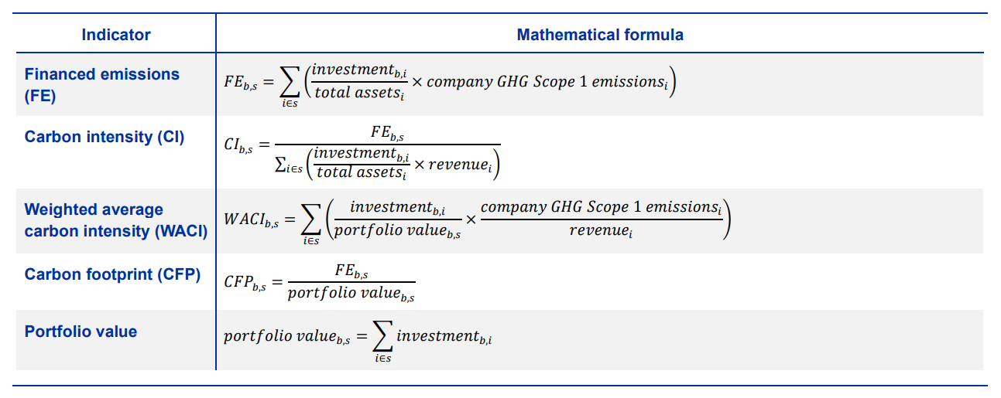
Absolute (FE) and relative indicators (CI,WACI,CFP)
Climate-related statistical indicators - technical Annex (europa.eu) contains equations/compilation steps/data sources for carbon (summarized here), green bonds and physical risks
Unit
Financed emissions: Tons of GHG emissions (Scope 1 is used as an example)
Relative indicators: Tons of GHG emissions per million EUR

Slide 13
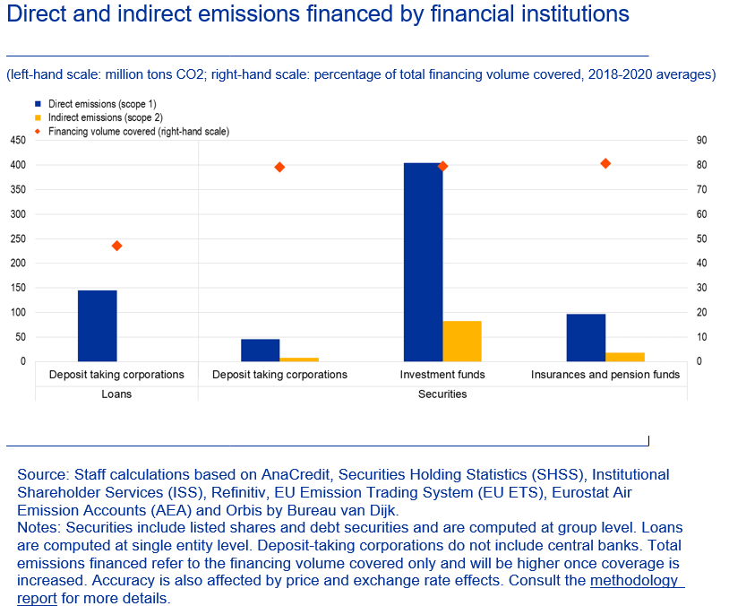
Financed emission indicator links absolute emissions and capital flows
Measure
Financed emissions: Tons of GHG emissions financed by euro area financial institutions
Key finding
Most euro area financial institutions’ funding of global emissions occurs via investment funds
Caveats
Coverage
Composition changes over time (see DNB study)
Notes:
This slide provides a first insight into the financed emission indicator
The indicators measure the level of emissions financed through respective channel, i.e. deposit taking cooperation (banks) or investment funds and insurance or pension funds
It is measured in tons of GHG emissions financed by euro area financial institutions
The right-hand chart shows the 3-year (2018-2020) average euro area breakdown by financial institution and shows that most euro area financial institutions’ funding of global emissions occurs via investment funds. Since this is an absolute indicator, this is a reflection of the fact that investment funds have the largest portfolios in the breakdown
Therefore, this indicator is complemented by two other indicators:
the Carbon Footprint indicator (also available among the dataset) which standardizes the financed emissions by the portfolio value. It shows that indeed the banking sector has the highest exposure once one looks at the ratio of both
In addition, this indicator does not consider how efficiently emissions are used to produce goods and services. We will see this in a minute on the next slide
As discussed earlier, the indicator suffers from caveats, most notably the coverage that attenuates the level. To allow for a better interpretation we provide in addition the coverage rates. They can be seen as a measure of confidence for the users and help to develop own ways to extrapolate from the current data
Due to this lower coverage also the composition of the underlying sample changes over time. This chart therefore shows a three-year average of the euro area indicator

Slide 14
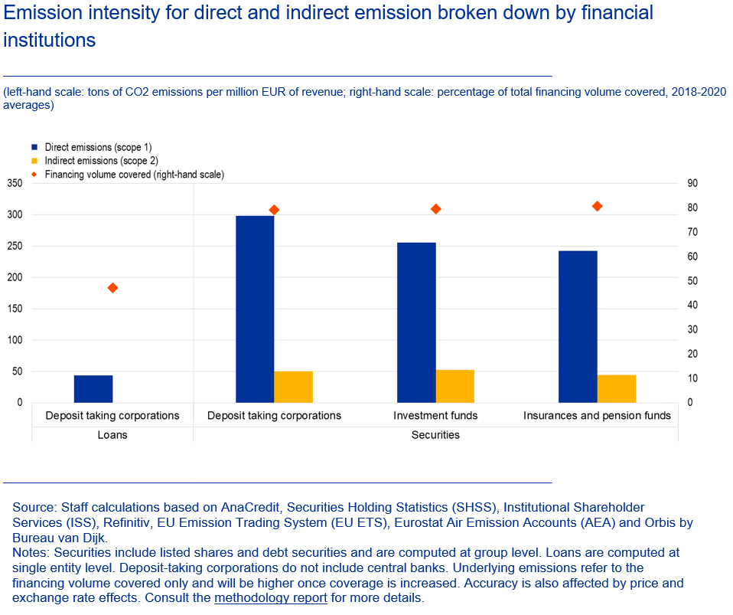
Banking sector: highest exposures and most carbon-intense financing
Measure
Carbon Intensity: tons of GHG emissions per million EUR of revenue
Key finding
In relation to their firms’ revenues, banks finance the most polluting economic activities
Caveats
Coverage
Price and exchange rate adjustment (see DNB study)
Composition changes over time (see DNB study)
Notes:
Complementing the previous slight this slide provides a first insight into the carbon intensity indicators
The carbon intensity is constructed by putting the financed emissions in relation to the revenues financed by the financial sector. As such it provides an intuition into how efficiently emissions are used by a company
The indicator is measured in tons of GHG emissions per million EUR or revenue
The right-hand chart shows the 3-year average (2018-2020) of the euro area breakdown by financial institution and illustrates in relation to their firms’ revenues, banks finance the most polluting economic activities
As discussed earlier, the indicator suffers from caveats,
Since this is a relative indicator, the underlying assumption is that the numerator and the denominator are representative of the full loan (respectively securities) population-an assumption that does not necessarily need to hold! This holds for all relative indicators, i.e. also the WACI and the Carbon Footprint not shown here.
Again, to allow for a better interpretation we provide in addition the coverage rates. They can be seen as a measure of confidence for the users and help to develop own ways to extrapolate from the current data
Due to this lower coverage also the composition of the underlying sample changes over time. This chart therefore shows a three-year average of the euro area indicator
Banks have a higher carbon intensity because they fund higher emitting firms in sectors to which the financial sectors have most exposures (manufacturing, services).
Optional: Mention price and exchange rate and decomposition effects.

Slide 15
4
4. Physical risks
Analytical indicators

Slide 16
Physical risks indicators link financial institution portfolio to natural hazards
Physical risks can be transmitted to the financial system through both macroeconomic and microeconomic impacts, including impacts on corporates, households, sovereigns or other financial institutions.
Bottom-up geospatial approach on company level for calculations of 7 seven acute natural hazards based on public data sources.
Estimates the potential and expected exposure of financial portfolios to physical risks such as coastal and river flooding, storms, water stress, wildfire, landslides or subsidence.
The indicator have several caveats that should be taken into account for their interpretation: Company assets are not always localisable, disregard of protection measures, insurances and collateral, compound events.
Notes:
This slide introduces the physical risk indicators
First, would be worth to mention again that physical risks are important for central banks since they can affect the financial system via different channels in the economy. For instance, by damaging household or company assets and also indirectly by the disruption of supply chains. (For instance: Almost annual problem in Germany low water depth of Rhein or Main, impede the transportation of material and goods. )
The here presented physical risk indicators are developed in a bottom up approach, starting from the location of company assets and investigating which physical hazards are relevant in this specific location, with which probability they may occur and with which intensity. This information is then linked to the financial portfolios.
We have three types of indicators, starting from rougher concept of just looking at the potential risk in a location to a classification of this risk in scores and finally to an estimation of the actual expected loss.
However, there are several points that need to be addressed by the developers to improve the stability and reliability of the indicators. For instance, the location of company assets is not always available, which is important to know since many of the physical risks such as for instance flooding is very location sensitive. Another issue is that in many countries protection measurements against physical hazards are implemented, best example here NL against coastal flooding. This measurements are not yet included in the indicators.

Slide 17
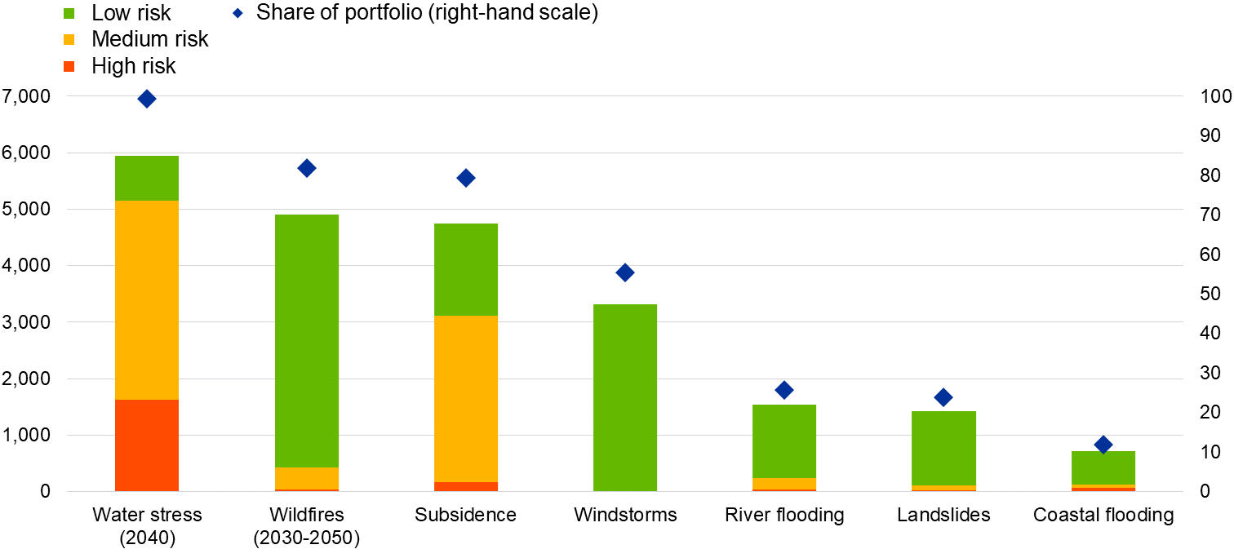
Hazard-specific Risk Scores for financial portfolio exposure
(Euro area, left-hand scale: EUR billions; right-hand scale: percentage of portfolio)
Measure
Hazard-specific risk scores: Indicate the percentage of the portfolio that is associated with a specific risk class from no risk to high risk.
Key finding
For most of the hazards assessed, a very large share of the potential risk exposure is allocated into the lowest risk category.
Caveats
Not comparable across hazards
Does not provide information on the intensity or actual damage.
Source: ESCB calculations based on data from analytical credit datasets AnaCredit, Securities Holding Statistics (SHS), Joint Research Centre (JRC), Copernicus, World Resource Institute (WRI) and NASA.
Notes: Risk scores are not comparable across hazard types because the scores rely on different methodologies and sources: water stress (scores derived from WRI based on the ratio between water demand and water supply), wildfires (scores from own calculations based on expected area burned), subsidence (scores from JRC based on the percentage of clay and sand in the soil), windstorms (scores from own calculations based on expected windspeed at return periods of 10, 50, 100 and 500 years), river and coastal flooding (scores from own calculations based on expected water depth of flooding in return periods of 10, 50, 100 and 500 years), landslides (scores from the JRC and adapted according to the return periods of 10, 50, 100 and 500 years). Indicators for water stress and wildfires are based on projected data for 2040 and 2030-2050 respectively. Protection measures, insurance and collateral are not taken into account. AnaCredit and SHS data are for December 2020.
Notes:
This slide shows the findings of the risk score indicators. The potential risk of the seven hazards classified in risk scores from low to high.
At this moment the risk scores are hazard specific and can therefore not be compared across hazards. (Exception are windstorms, coastal and river flooding, they are comparable)
Potential risk is higher for risks that do not depend so much on a very specific geographical condition (such as rivers or mountains).
For Water stress and wildfire, the data is projected for 2040 and 2030-2050, which gives and additional indication why potential risk might be higher there. Also both risks are highly correlated with an increase in drought and temperatures which are one of the most expectable effects of climate change in coming decades.

Slide 18
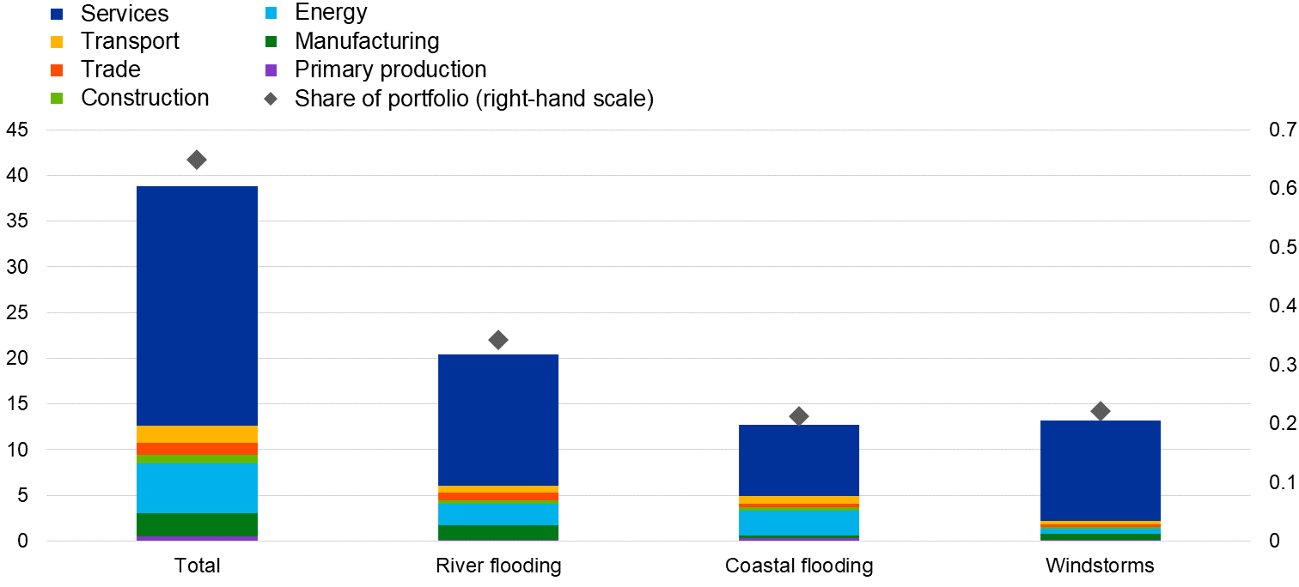
Normalized Exposure at Risk (NEAR)
Measure
NEAR shows the % of the financial portfolio at risk that is annually expected to be affected by hazard events.
Euro area, left-hand scale: EUR billions; right-hand scale: percentage of portfolio
Key finding
Higher expected damage associated with river flooding than with coastal flooding or windstorms. Services most affected reflecting its high share in the economy.
Caveats
Only available for three hazards
Damage costs available only on country level.
Source: ESCB calculations based on data from analytical credit datasets AnaCredit, Securities Holding Statistics (SHS), Joint Research centre (JRC), Copernicus and Orbis by Bureau van Dijk
Notes: Information in this chart is based on expected annual damages caused to physical company assets by each hazard. Protection measures, insurance and collateral are not taken into account. AnaCredit and SHS data are for December 2020.
Notes:
This slide shows the Normalized exposure at risk indicator, which is the most advanced indicator of the three.
While the other two indicaotr types do not give any information about the actual damage the hazard event may cause, this dimension is included in this indicator. This means that the probability and the intensity of a hazard event to happen but also for instance the estimated resistence of buildings is taken into account.
And this makes an important difference, for instance while the graph for windstorms shows a significant higher potential risk than coastal and river flooding, the actual damages are expected to be lower.
As you can see, the largest exposure is with the service section, reflecting its high share in the economy.

Slide 19
5. Conclusion

Slide 20
Conclusion
Climate-related indicators are necessary to understand the risks associated with climate change for the financial sector, as well as the financing needs for the transition
Our approach adds value as both data sources and methodology are fully transparent and results are internationally comparable
These initial indicators come with limitations – like all similar data at this point in time – but provide already some relevant insights and more importantly form the starting point for our discussion with you to improve our products!
The data will become more accurate and relevant as the methodology evolves and more relevant/transparent/public and commercial data sources are integrated
DNB will continue to be heavily invested in this joint work of the ECB and other ESCB central banks by co-chairing the STC EG CCS together with the ECB colleagues and providing methodological improvements based on our research, please see:
Five questions on our new sustainability figures (dnb.nl)

Slide 21
Discussion, Q&A
[Please select]
[Please select]

