Slide 2
Inequality in the life-course
Who grows up to become what?
Tanja Traag
November 12, 2020

Slide 3
In this presentation
Key moments in the life course
Mechanisms in the transmission of intergenerational inequality
Economic capital: Growing up in poverty
Social capital: Family structures
Human capital: Parental education
Cultural capital: elite behaviour
Time for asking questions

Slide 4
Key moments in the life-course
Source: Municipal population registries

Slide 5
Intergenerational transmission of inequality
Intergenerational transmission of inequality
Economic capital
Ability to provide material goods
Human capital
Ability to provide cognitive stimulation
Social capital
Ability to transmit resources
Cultural capital
Ability to enable adjustment to dominant cognitive culture

Slide 6
Growing up in poverty
Source: European Union Statistics on Income and Living Conditions (EU-SILC)
Notes:
https://www.cbs.nl/nl-nl/nieuws/2019/50/aantal-kinderen-in-armoede-bleef-in-2018-gelijk-langdurige-armoede-daalde
https://www.cbs.nl/en-gb/news/2019/50/child-poverty-stable-in-2018-less-long-term-poverty
https://longreads.cbs.nl/armoede-en-sociale-uitsluiting-2019/armoede-en-sociale-uitsluiting-bij-kinderen/

Slide 7
Growing up in poverty
Source: European Union Statistics on Income and Living Conditions (EU-SILC)

Slide 8
Consequences of poverty
Source: European Union Statistics on Income and Living Conditions (EU-SILC)

Slide 9
Disadvantaged at birth?
Source: Municipal population registries
Notes:
https://www.cbs.nl/nl-nl/achtergrond/2015/45/gezinsdynamiek-ouderlijk-opleidingsniveau-en-schoolniveau-van-vijftienjarigen
https://www.researchgate.net/publication/254297225_Early_school-leaving_in_the_Netherlands_The_role_of_family_resources_school_composition_and_background_characteristics_in_early_school-leaving_in_lower_secondary_education

Slide 10
Post-divorce family structures
Source: Municipal population registries, Parent-child ties
Notes:
https://www.cbs.nl/nl-nl/achtergrond/2015/45/gezinsdynamiek-ouderlijk-opleidingsniveau-en-schoolniveau-van-vijftienjarigen
https://www.cbs.nl/nl-nl/nieuws/2020/40/ruim-een-half-miljoen-minderjarigen-in-complexe-gezinsverbanden
https://www.cbs.nl/nl-nl/longread/statistische-trends/2020/kinderen-in-complexe-gezinsverbanden

Slide 11
Human capital: parental education
Source: Labour force surveys 2001-2009
Notes:
https://www.cbs.nl/nl-nl/nieuws/2011/51/een-op-de-drie-kinderen-volgt-ouders-in-opleiding
https://www.cbs.nl/nl-nl/nieuws/2018/41/schooladvies-vaker-bijgesteld-bij-lagere-inkomens
https://www.cbs.nl/nl-nl/achtergrond/2017/26/invloed-ouderlijk-opleidingsniveau
https://www.researchgate.net/publication/38957716_How_Much_Does_Education_Matter_and_Why_The_Effects_of_Education_on_Socio-economic_Outcomes_among_School-leavers_in_the_Netherlands
https://www.cbs.nl/nl-nl/achtergrond/2012/50/early-school-leaving-in-the-netherlands-a-multidisciplinary-study-of-risk-and-protective-factors-explaining-early-school-leaving

Slide 12
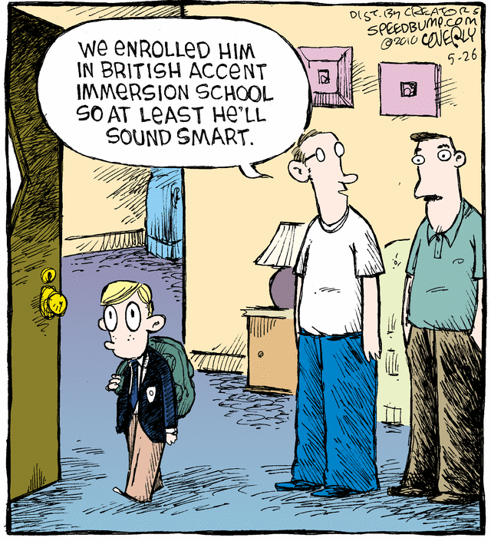
Cultural capital
Notes:
Chapter 2 of https://www.cbs.nl/nl-nl/achtergrond/2012/50/early-school-leaving-in-the-netherlands-a-multidisciplinary-study-of-risk-and-protective-factors-explaining-early-school-leaving

