Slide 1
Perspectives of CBS Microdata Services
Ruurd Schoonhoven

Slide 2
Content
Q&A facility (under consideration; upon input user council)
Audit on security and privacy protection
ODISSEI and the ODISSEI Secure Super Computer

Slide 3
Q&A facility (under consideration)
CBS receives many questions from users, several of them very similar
Attempt to create a wiki as a user discussion platform (~2016) failed because of virtually no user input
CBS considers creating a Q&A or FAQ list in the RA environment, based on the questions that we receive

Slide 4
Q&A facility
Question to microdata users
Would such a facility work for you?
Which topics are most relevant to be included?
Reactions welcome by e-mail
To microdata@cbs.nl
Subject ‘Q&A’

Slide 5
Audit on security and privacy protection
CBS respects the highest standards on security and privacy protection
An external audit was performed Jan-Oct 2020 by a team led by Prof B. van den Berg (UL, Cyber Security)
General conclusions positive, but attention is needed to certain aspects of
Users (institutes & researchers)
Use (what are researchers allowed to do)
Data (pay more attention to particularly sensitive datasets)
Processes and procedures (transparancy, consistency)

Slide 6
Audit on security and privacy protection
CBS will formulate scenarios as to how to proceed
To be discussed with user council and other stakeholders
More concrete proposals spring 2021
To be expected: the general setup of Microdata Services will remain unchanged, but procedures may become more strict in specific aspects

Slide 8
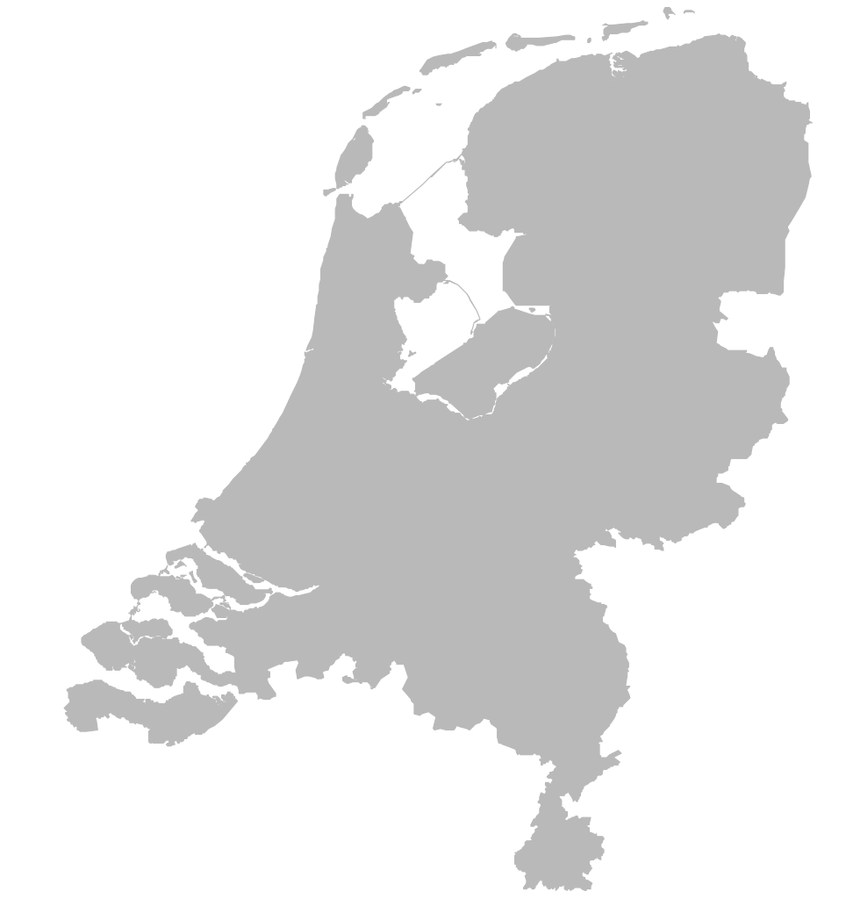
A unique collaborative consortium
ODISSEI is creating a data infrastructure for the social sciences in the Netherlands, on behalf of 40 member organizations.
Notes:
There are huge amounts of data about people, organisations, neighbourhoods, etc.
Societal questions are increasingly more complex.
Computing technologies are rapidly developing.
Need for an organised response from the social sciences
Open Data Infrastructure for Social Science and Economic Innovations
Dates back to 2014 (NDSW)

Slide 9
ODISSEI microdata programme
Supporting its members using CBS microdata by
Discount up to 50% for regular RA projects (currently ~120 projects)
Yearly grants for 5-8 free RA projects up to 7,5 k€
Supporting CBS in developing and improving services

Slide 10
ODISSEI Secure Super Computer
Extended and full privacy proof access of RA projects to national supercomputer Cartesius at SURF
Developed in collaboration between CBS, SURF and ODISSEI
Proof of Concept and three pilot projects succesfully finished over last 3 years
Launched for general use October 1, 2020

Slide 11
ODISSEI Secure Super Computer

Slide 12
ODISSEI Community meeting (online)
Tuesday afternoon, November 24
Check www.odissei-data.nl

Slide 13
Questions?
www.cbs.nl/microdata
microdata@cbs.nl
www.odissei-data.nl

