Slide 1
Inequalities in employment and health
Merel Schuring
Department of Public Health
Erasmus University Medical Center
Rotterdam, The Netherlands
Notes:
Hebben jullie de e-module doorlopen?
Zijn er nog vragen naar aanleiding van de e-module?

Slide 2
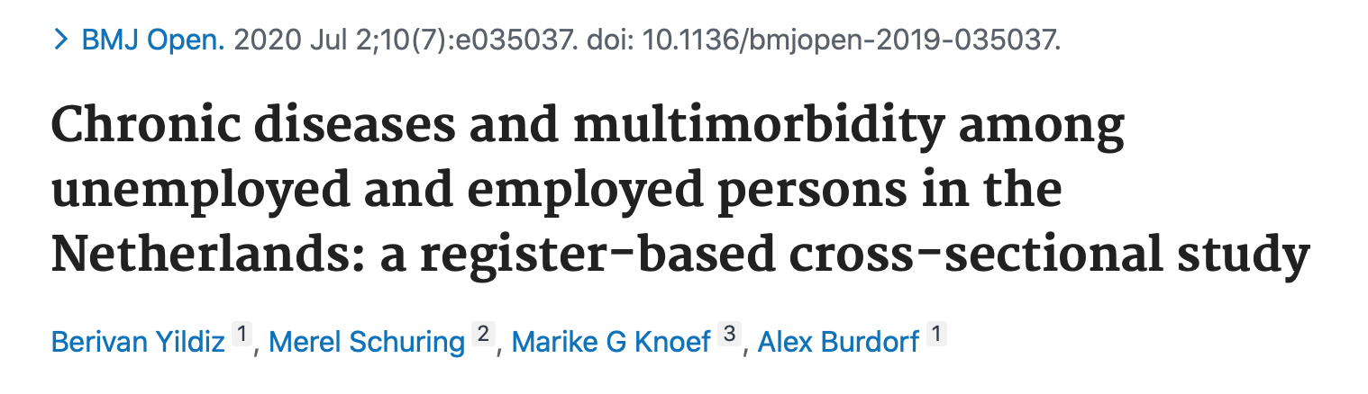
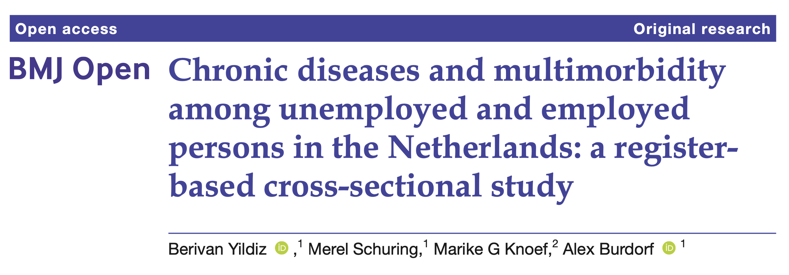
Introduction
Health inequalities between employed and unemployed persons
Unemployed persons more often have mental or physical health problems
Most research based on self-reported health
Registry data
Pharmacy data: identification of specific chronic diseases & multimorbidity
Large coverage (all residents of the Netherlands) and reliable information
Precise estimations of prevalence of diseases
Aims
Prevalence of chronic diseases and multimorbidity among unemployed and employed persons
Age-specific prevalence of chronic diseases among unemployed and employed persons

Slide 3
Methods
Study population (aged 18-65 years in 2016)
4,566,644 employed persons
507,583 unemployed persons
Chronic diseases
Medication registration – puchased drugs in 2016 – reimbursed by health insurers
ATC classification codes - identification specific chronic diseases
Logistic regression analyses
Independent: employment status & sociodemographic characteristics
Dependent: chronic diseases (1,2 or ≥3)
Stratified analysis for different age groups

Slide 4
Results
 | Unemployed N=507,583 % | Employed N=4,566,644 %
Age - 18-30 - 30-45 - 45-55 - 55-65 | 11 31 29 29 | 27 40 23 11
Female | 55 | 47
Education - high - intermediate - low | 15 34 52 | 44 42 14
Ethnic background - Non-native Dutch | 48 | 19

Slide 5
Unemployment & chronic diseases

Slide 6
Unemployment & multimorbidity
 | Number of chronic diseases
 | 1 | 2 | ≥3
 | OR ( 95% CI) | OR ( 95% CI) | OR ( 95% CI)
Employed | 1 | 1 | 1
Unemployed | 1.30 (1.29-1.31) | 1.74 (1.73-1.76) | 2.59 (2.56-2.61)
Adjusted for age, sex, education, and ethnic background

Slide 7
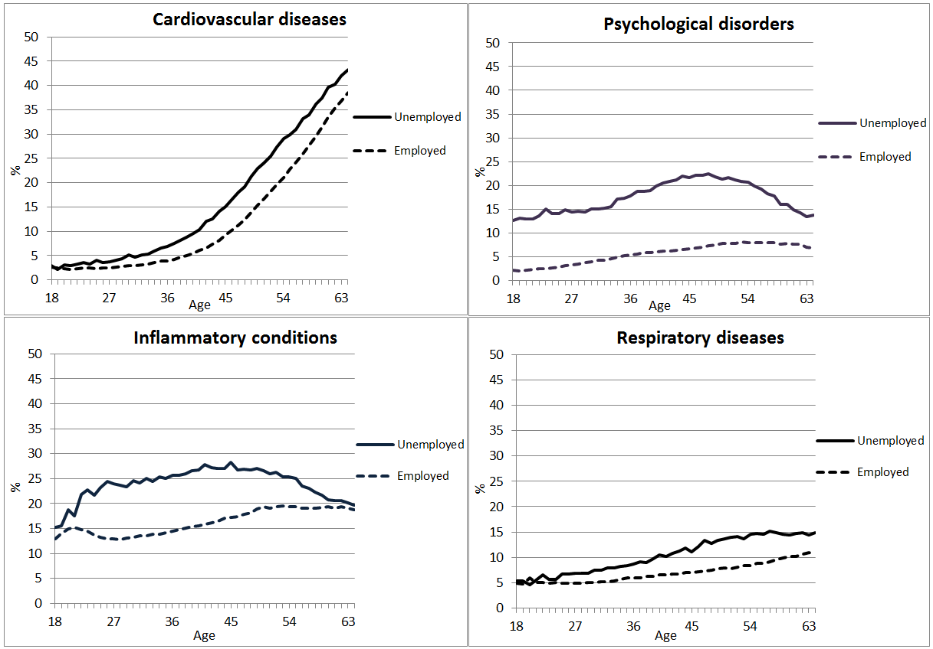
Age-specific prevalence of diseases

Slide 8
Age groups: unemployment & diseases
 | Number of chronic diseases
 | 1 | 2 | ≥3
 | OR ( 95% CI) | OR ( 95% CI) | OR ( 95% CI)
Age 18-30
Employed | 1 | 1 | 1
Unemployed | 1.65 (1.61-1.69) | 2.84 (2.75-2.93) | 5.20 (4.99-5.42)
Age 30-45
Employed | 1 | 1 | 1
Unemployed | 1.41 (1.39-1.43) | 2.12 (2.09-2.16) | 3.52 (3.45-3.59)
Age 45-55
Employed | 1 | 1 | 1
Unemployed | 1.22 (1.20-1.23) | 1.64 (1.61-1.67) | 2.66 (2.62-2.70)
Age 55-65
Employed | 1 | 1 | 1
Unemployed | 1.09 (1.07-1.11) | 1.29 (1.26-1.31) | 1.78 (1.76-1.81)
Adjusted for sex, education, ethnic background

Slide 9
Discussion
Unemployed persons
Higher prevalence of psychological disorders, cardiovascular diseases, inflammatory diseases, repiratory diseases, diabetes and psychotic illness
More likely to have multimorbidity (especially among younger persons!)
Policy implications
Reduce health inequalities between employed and unemployed persons
Employment is an important determinant of health
Promote employment among unemployed persons with chronic diseases to improve health

Slide 10
Strengths and limitations
Pharmacy data
Strengths
Covers a large population
Reliable information
Limitations
Not all diseases can be identified by medication
- Musculoskeletal disorders or back pain (over the counter pain killers)
Cross-sectional design
Causal relationships between unemployment and health

Slide 11
Overview of current projects
Investigating employment and health in longitudinal studies:
The influence of chronic diseases and multimorbidity on entering paid employment among unemployed persons
The influence of entering paid employment on health among unemployed persons
The influence of exit from paid employment to unemployment on health
Working life expectancy and working years lost stratified by educational groups and by persons with or without health problems
Investigating the effectiveness of employment services of the municipality on entering paid employment and health among unemployed persons
Register data municipality
Register data Statistics Netherlands

Slide 12

Merel Schuring
m.schuring@erasmusmc.nl
Department of Public Health
Erasmus University Medical Center
Rotterdam, The Netherlands

Slide 13
Identification of diseases – ATC codes
Chronic disease | ATC-code | Medication class
Cardiovascular disease | B01A C01 C03A C08 C07 C09A, C09B | Antithrombotic agents Cardiac agents Low-ceiling drugs Calcium channel blockers Beta blocking agents ACE inhibitors
Psychological disorders | N05B N05C N06A | Anxiolytics Hypnotics and sedatives Antidepressants
Inflammatory and antirheumatic products | M01A | Antiinflammatory and antirheumatic products, non-steroids
Respiratory diseases | R03A, R03C R03B, R03D | Adrenergics (inhalants) Other drugs for obstructive airway diseases
Psychotic illness | N05A | Antipsychotics
Diabetes mellitus | A10A A10B | Insulins and analogues Blood glucose lowering drugs

