Slide 1

Research on income and labour market inequality at CPB
Egbert Jongen
Statistics Netherlands, November 2020
www.cpb.nl/en | @CPBnl_uk

Slide 2
Outline
Motivation
Methodology
Data
Results
Concluding remarks

Slide 3
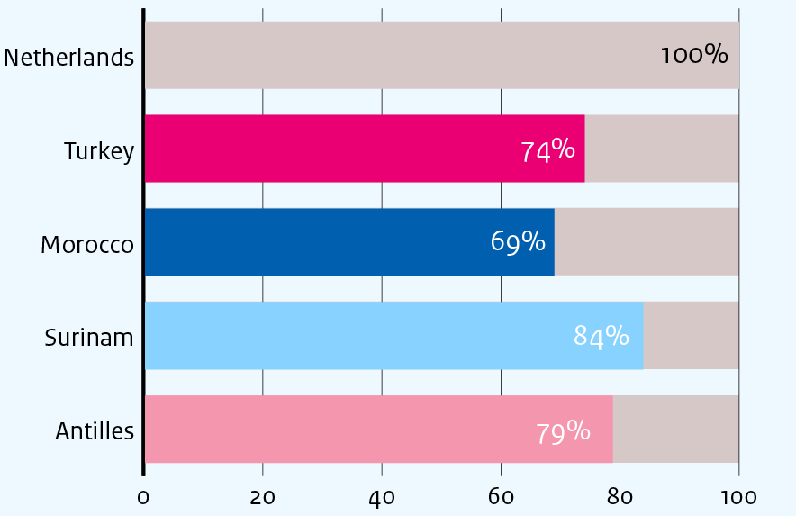
Motivation
Disposable household income, 30-40 year olds in 2017
There are large differences in income by migration background
Undesirable for equity and efficiency reasons
Question we ask: do these differences go away over generations?
Source: Own calculations using INHATAB of Statistics Netherlands

Slide 4
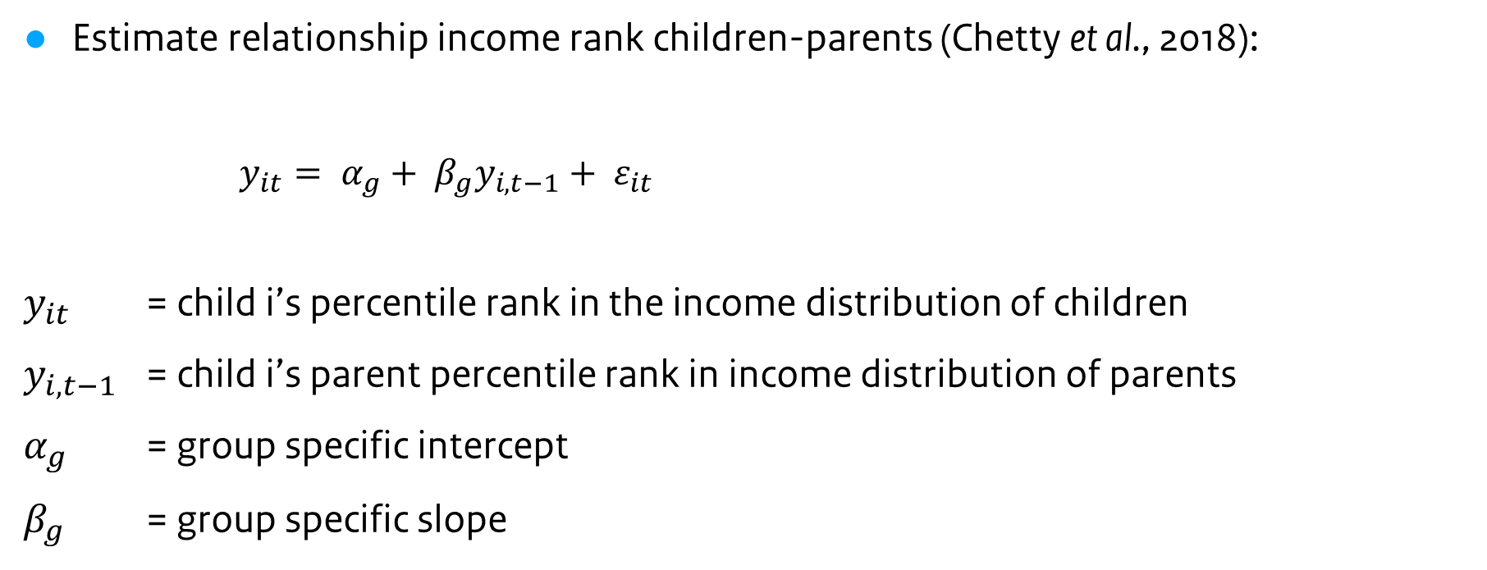
Methodology
Estimate relationship income rank children-parents (Chetty et al., 2018):
$y_{it}= α_{g}+ β_{g}y_{i,t−1}+ ε_{it}$
$y_{it}$ = child i’s percentile rank in the income distribution of children
$y_{i,t−1}$ = child i’s parent percentile rank in income distribution of parents
$α_{g}$ = group specific intercept
$β_{g}$ = group specific slope

Slide 5
Data
When do we measure income?
We measure the parents income in 2003 (child is 15-20 years of age)
We measure the children’s income in 2016 (child is 28-33 years of age)
Personal and household incomes available from Statistics Netherlands
Individual incomes (IPI 2003 and INPATAB 2016)
Disposable household incomes (IHI 2003 and INHATAB 2016)
Data from municipalities available from Statistics Netherlands
Age, gender, migration background

Slide 6
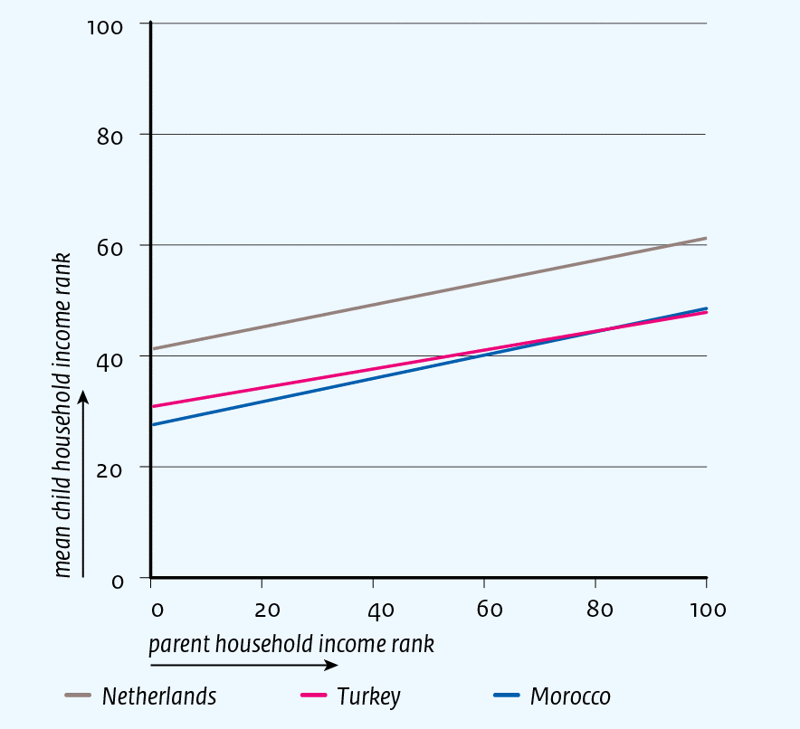
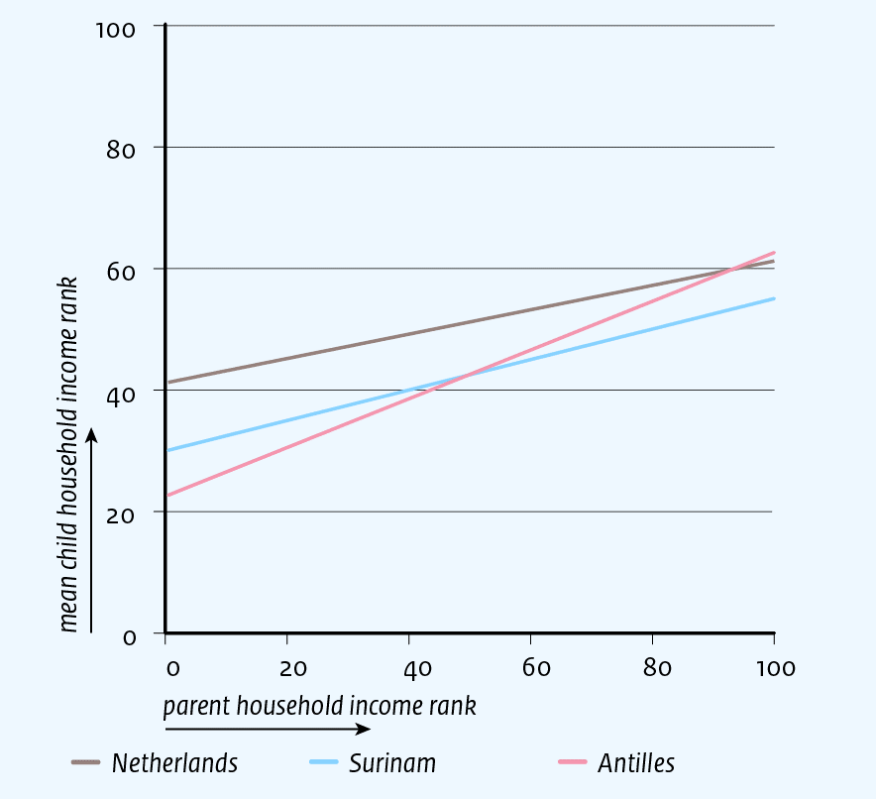
Results

Slide 7
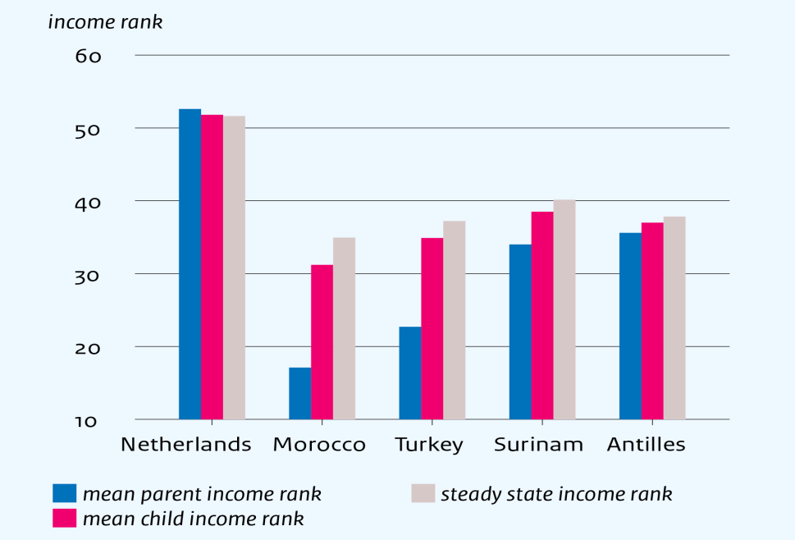
… if the same relationship holds in the future

Slide 8
Concluding remarks
Personal income without and with controlling for education:
30-40 year olds, 2013-2017
There are large and persistent differences in income by migration background
What can be done?
Better education is part of the answer
But also much remains to be done on the labour market
National government, municipalities, employers and people themselves
Read our study ‘Promising policies for integration on the labour market’
(joint with SCP)
Source: Own calculations using INPATAB and Labour Force Survey of Statistics Netherlands

Slide 9
Further reading
Link
Link

Slide 10
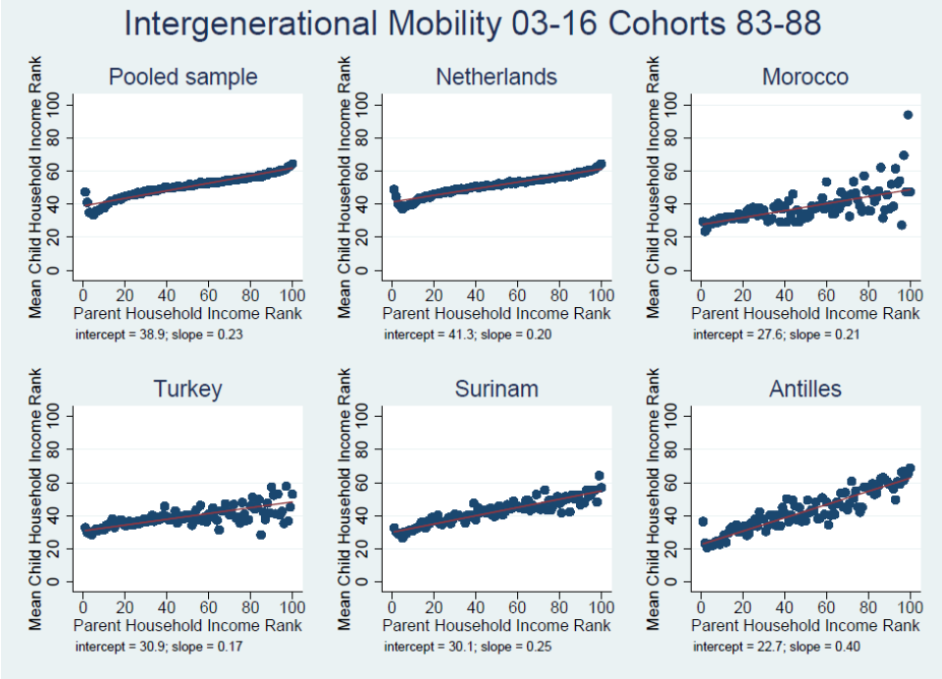
Raw data

