Slide 1
WELCOME to the Microdata User Webinar!
Dr. Annette Scherpenzeel

Slide 2
Content
Me
Guidelines Webinar
CBS Microdata Services in 2020
Today

Slide 3
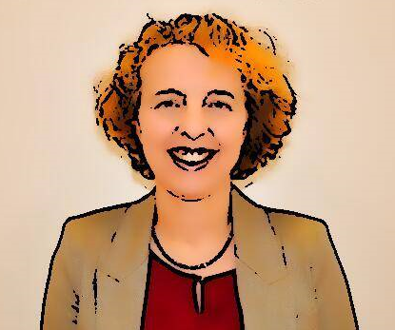
Me
Annette Scherpenzeel
Head of CBS Microdata Services, since September 1st.
Survey methodologist
UU, UvA, Swiss Household Panel, LISS panel, SHARE

Slide 4
Guidelines Webinar
Audio: Put your mic on mute during presentations
Chat: Write questions or remarks in the chat
Moderator will read out your question
Parallel sessions: zoom codes
Break out session

Slide 5
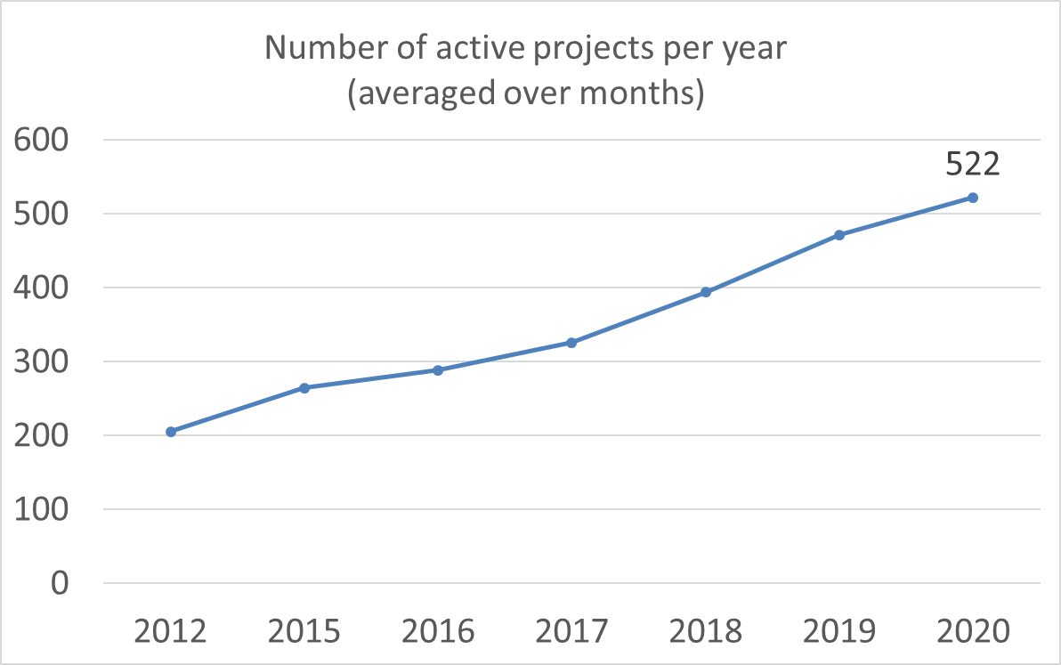
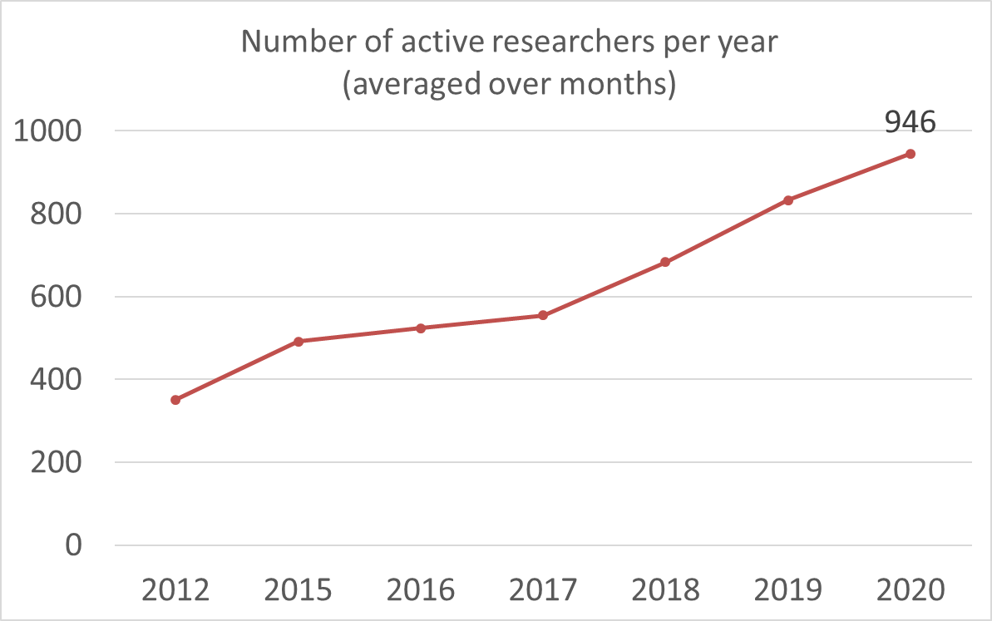
Microdata Services in 2020: Growth

Slide 6
Microdata Services in 2020: User evaluation
June 2, 2020: E-mail invitation including link to active researchers (958)
June 26, 2020: Reminder
Completed forms: 173 forms (2019: 133, 2018: 128, 2017: 104)
Other questions (rating in 5 categories):
Cost/quality
Information
Expertise
Processing time
Flexibility
Data quality
Documentation
Etc.

Slide 7
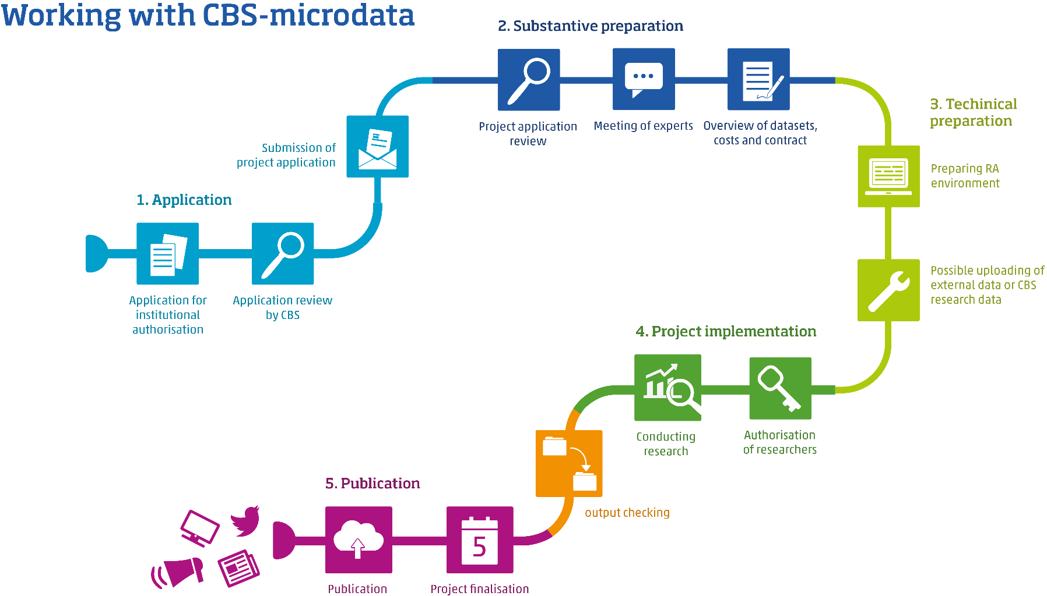
Microdata Services: Improvements
8 news RA servers, 2 extra strong
ODISSEI Secure Super Computer
Notes:
Extra servers: beginning of October

Slide 8
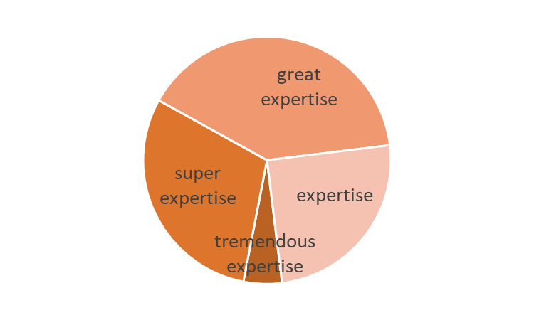
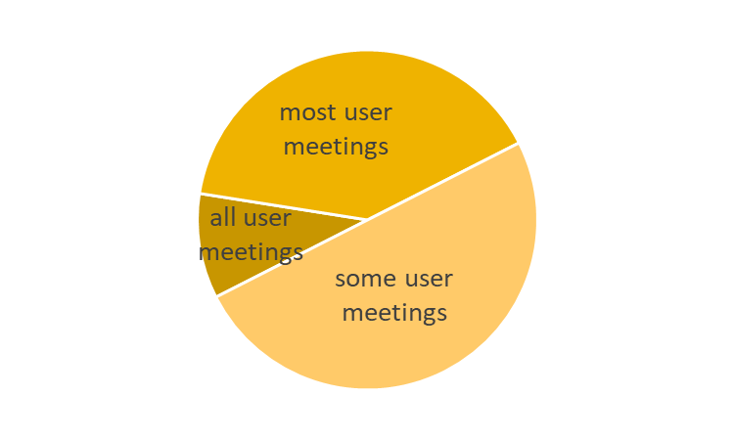
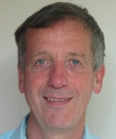
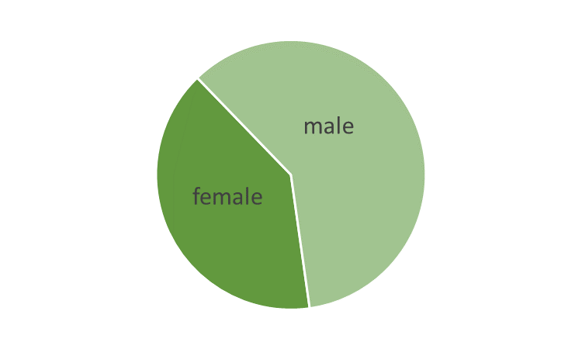
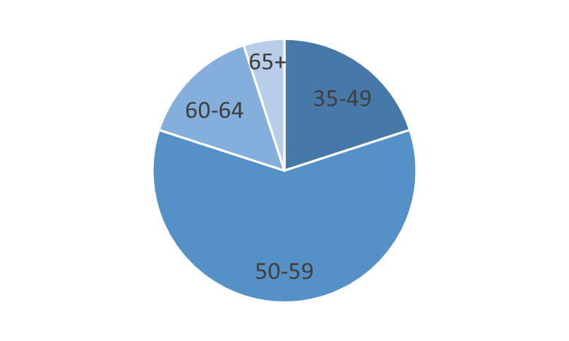
Some more statistics

Slide 9

Some more statistics
Notes:
16 years at CBS, retire spring 2021. All user days, etc.

Slide 10
Programme: Inequality
13:45 - 14:30 Plenary session:
Inequality in the life-course; who grows up to become what? Tanja Traag (CBS)
Research at CPB on inequality in incomes and labour market outcomes. Egbert Jongen (CPB)
14:30 - 14:45 Chat moment in smaller break out rooms
14:45 - 15:45 Parallel sessions:
A. Inequality and education
1. Who knows best, the teacher or the test? Kimberley Lek (CITO)
2. De onderwijsachterstandenindicator. Jaap Walhout (CBS)
3. Ongelijkheid in het onderwijs vanuit het stelseltoezicht. Maarten Balvers, Daan Fettelaar (Onderwijsinspectie)
B. Inequality and health
1. Hogere sociaaleconomische status, dus gezonder? Jan Willem Bruggink (CBS)
2. Perinataal gezondheids-programma in Rotterdam. Erik de Jonge (EUR)
3. Paid work and income after cancer. Sietske Tamminga (Amsterdam UMC)
C. Inequality and labour and income
1. Wie stroomt uit naar werk na langdurige bijstand? Sophie Doove (CBS)
2. Ongelijkheid over de levensloop. Sander Muns (TiU)
3. Inequalities in employment and health. Merel Schuring (EUR)
15:45 - 16:00 Perspectives of CBS Microdata Services. Ruurd Schoonhoven (CBS)
16:00 Closing. Annette Scherpenzeel (CBS)

